Slide 1
Nightking

Slide 2
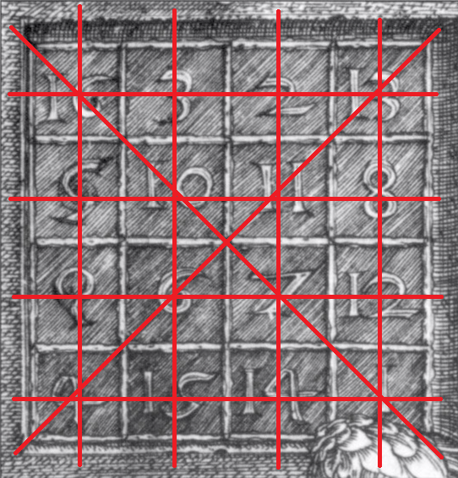

Magic Squares
Full magic
Numbers from 1 to $n^{2}$

Slide 3
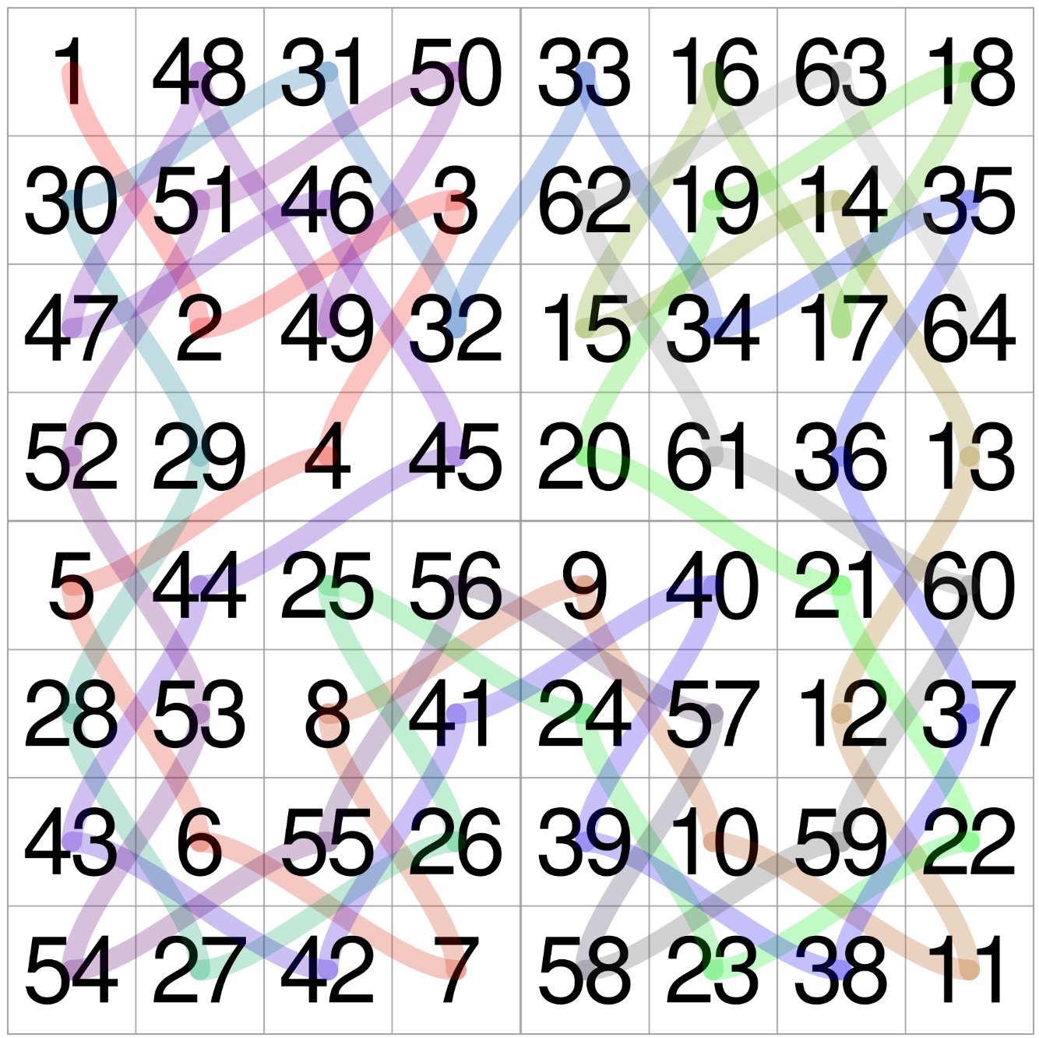
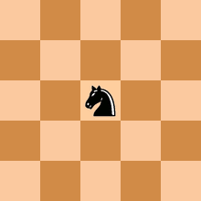
Knight’s Tours

Slide 4
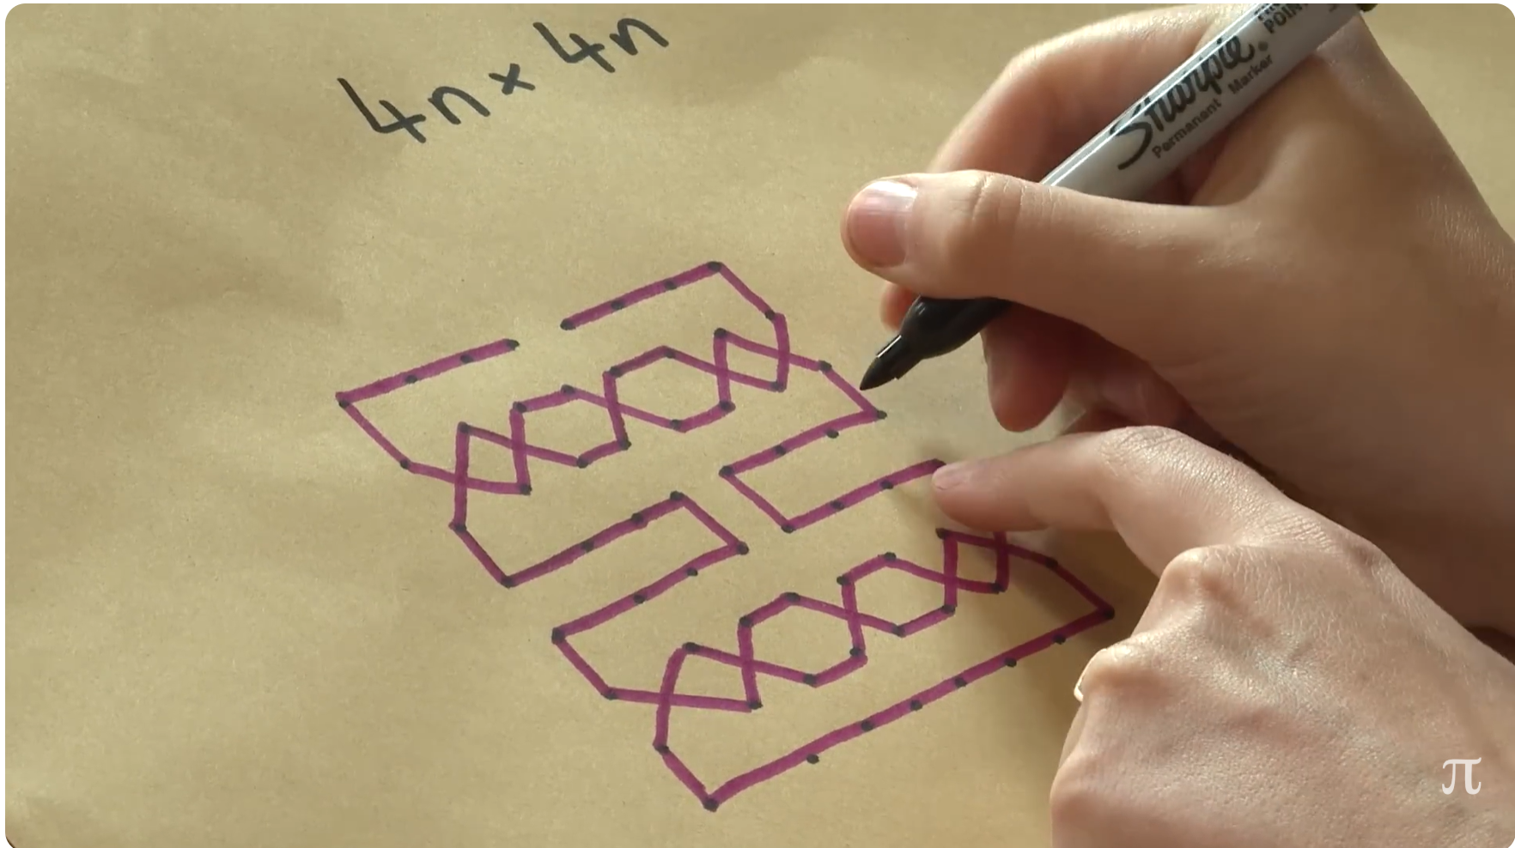
King’s Tours
(© numberphile)

Slide 5
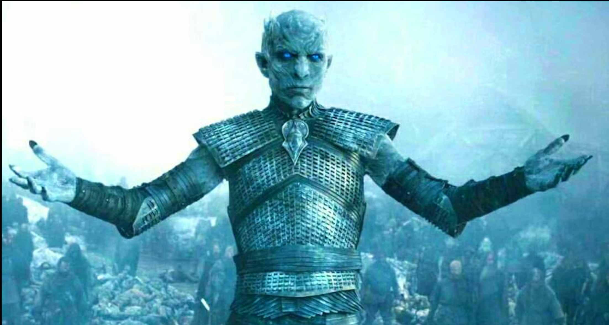

Slide 6
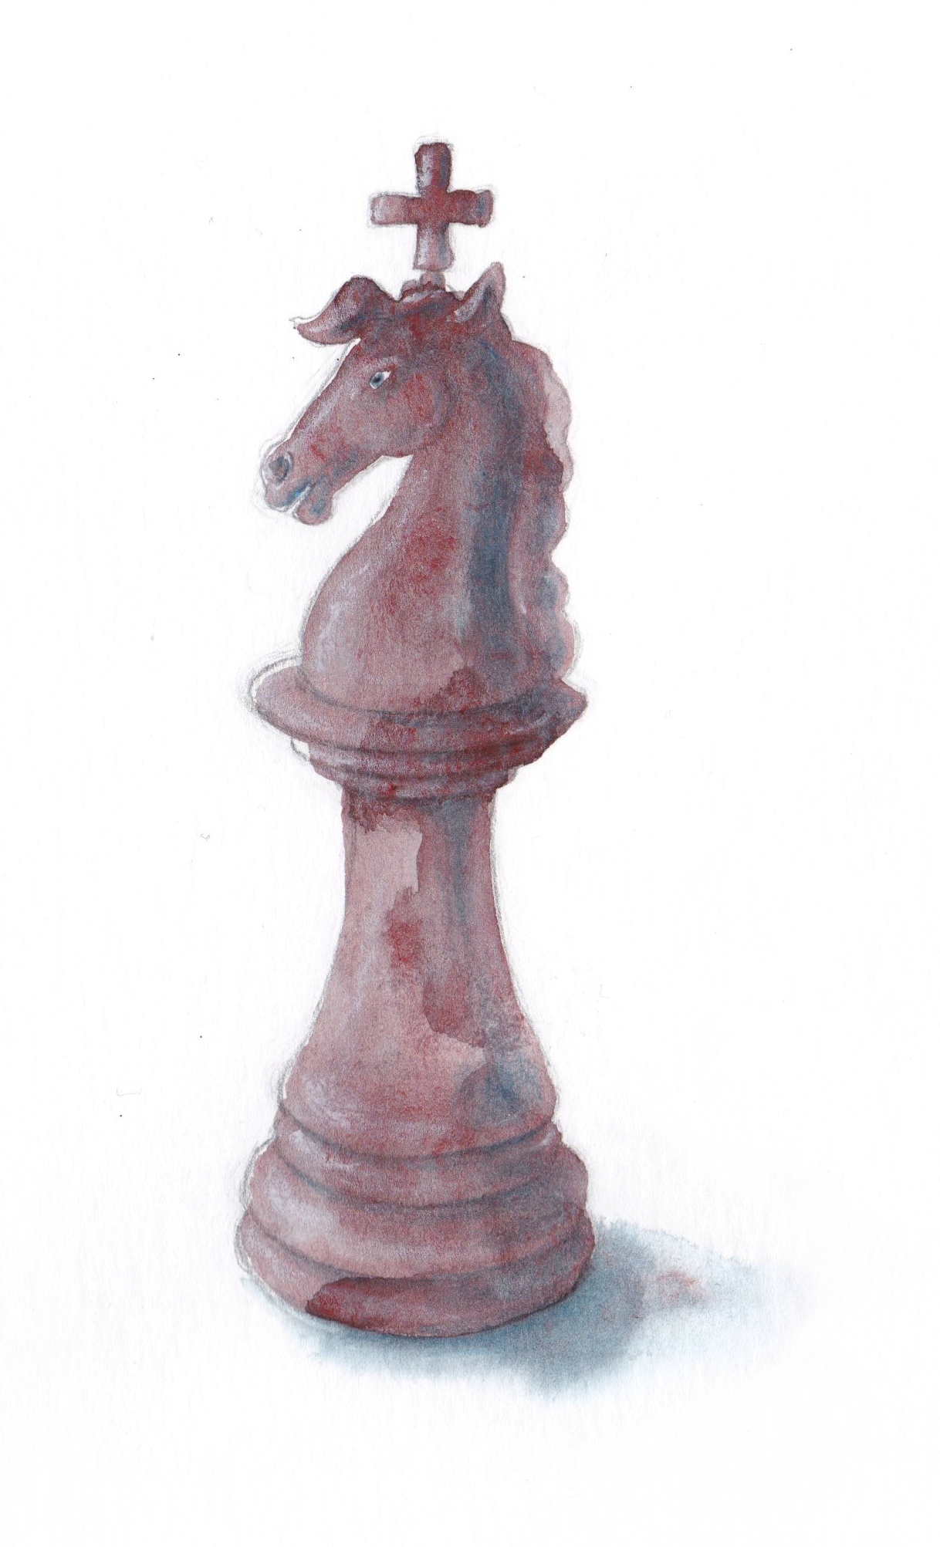
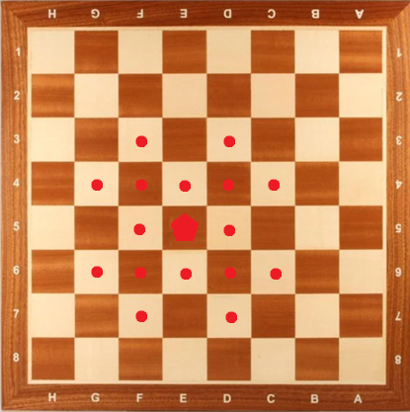
The Nightking

Slide 7
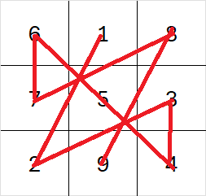
3x3
1 magic nightking’s tour (not closed)
0 magic king’s tour
0 (magic) knight’s tour

Slide 8
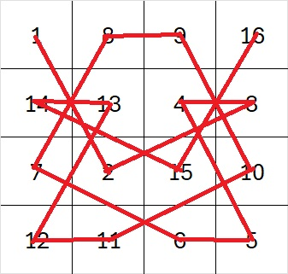
4x4
1 magic nightking’s tour (not closed)
0 magic king’s tour
0 (magic) knight’s tour

Slide 9

5x5
0 magic nightking’s tour

Slide 10
6x6 and 7x7
No magic king’s* or knight’s tours (* as far as the internet knows about it).

Slide 11
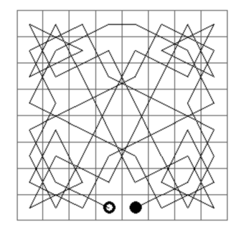
8x8
36 Magic knight’s tours with 1 king’s move in the middle
(closed: 12)
(reference: Yann Denef)

Slide 12
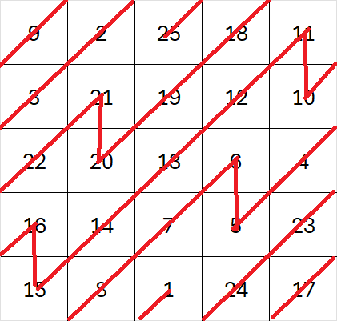
Going toral for fun and profit

